Slide 1
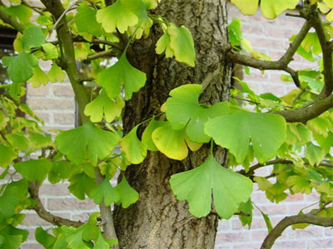
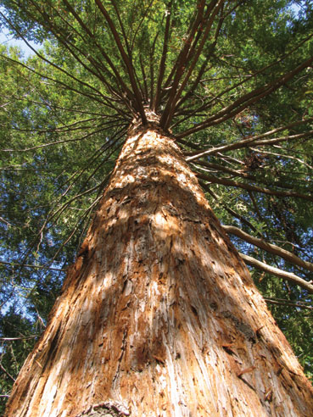
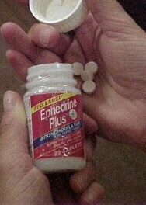
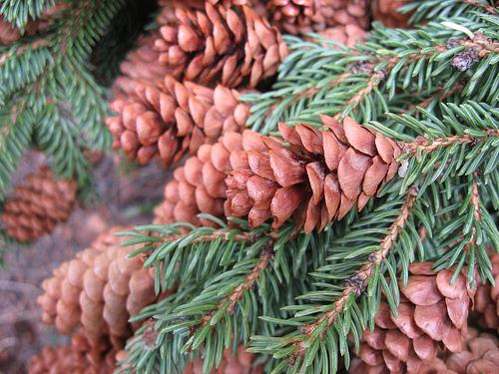
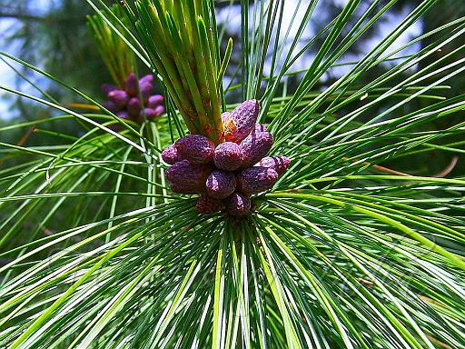
Economic Importance Of Gymnosperms
Submitted By :
G.Swapna
:ecturer in Botany

Slide 2
Ornamental
Paper
Source of Wood
Essential Oils
Medicinal Uses
Uses of Gymnosperms
Resins
Tannins
Fatty oils
Fibers
Edible Products

Slide 3
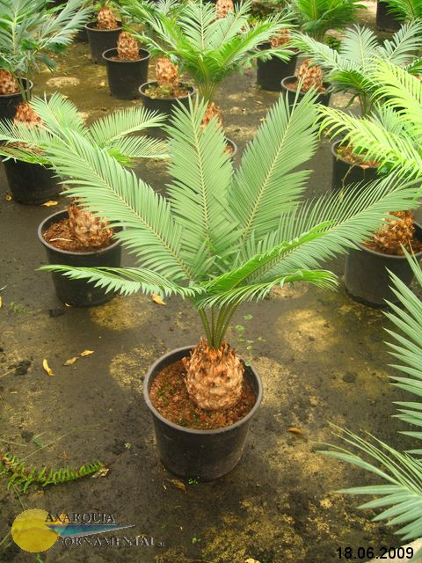
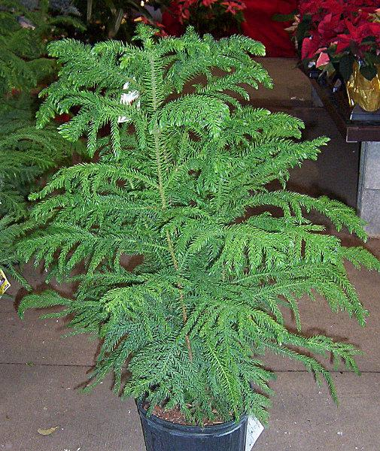
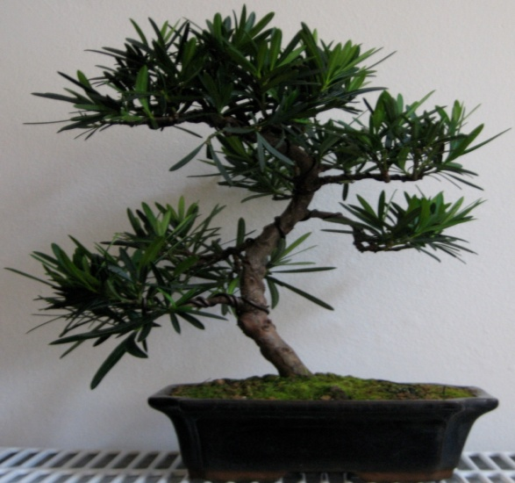
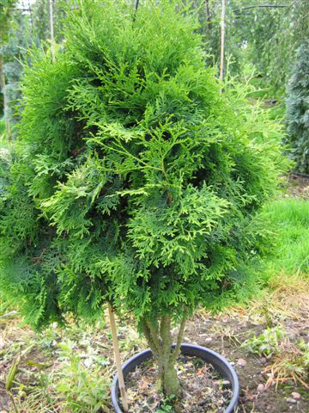
Ornamental
Cycas sp.
.
Araucaria sp.
Podocarpus sp.
Thuja sp.

Slide 4
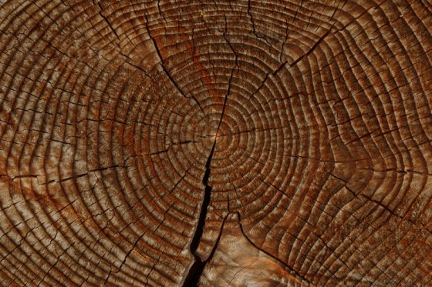
Source of Wood

Slide 5
Properties of Wood
Wood is light coloured
Straight grained
Light weight
Wood gets good paint
Bear good nail taking properties
It takes good finish

Slide 6
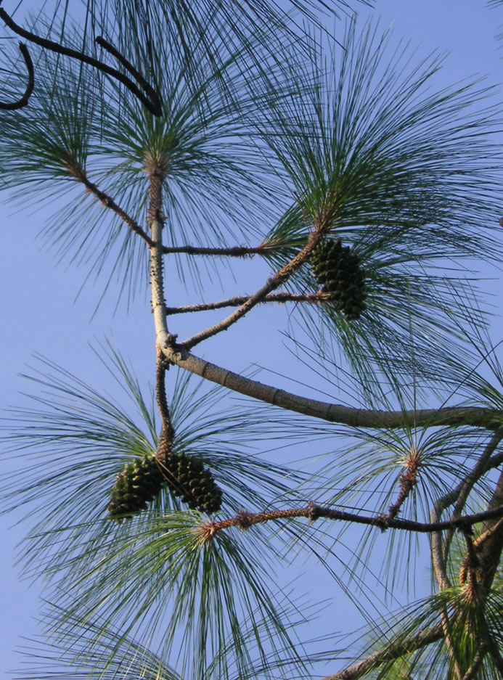
Pine (Chir)
P.roxburghii
P.sylvestris
P. Wallichiana
Uses
Good quality timber
Cheap furniture
Wooden frames
Packing cases
Pinus roxburghii (Chir )

Slide 7
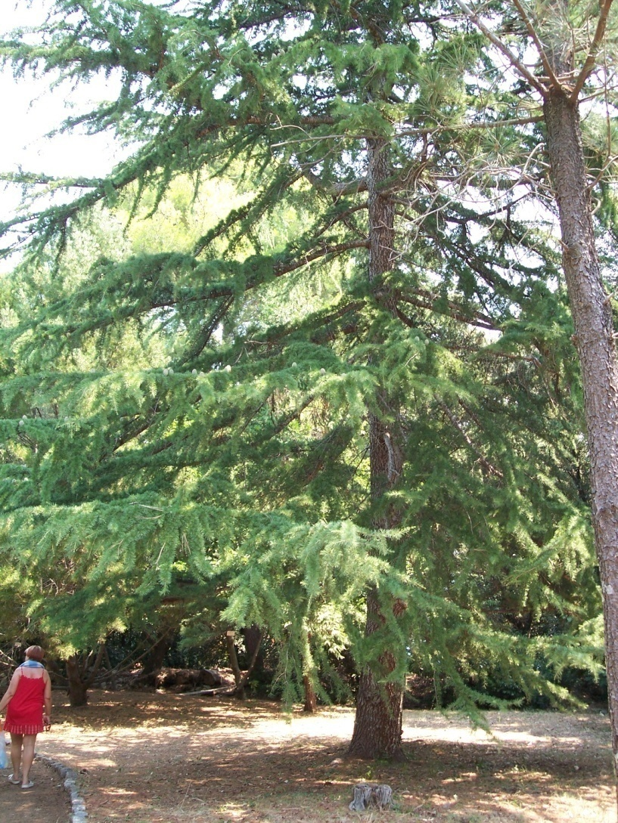
Cedar Wood (Cedrus deodara)
Strongest Indian timber
Wood is scented and resistant to insects & fungus attacks
Uses :
for making railway sleepers, doors, window pans, boats & furniture
Cedrus deodara

Slide 8
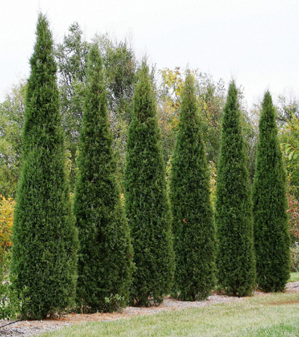

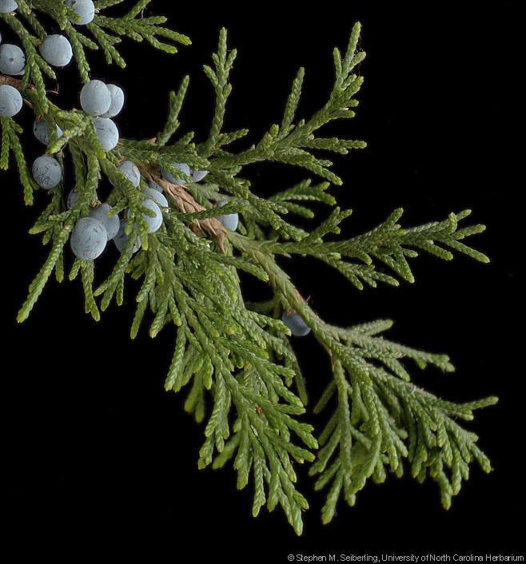
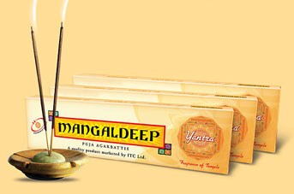
Red cedar (Juniperus virgiana)
Uses

Slide 9
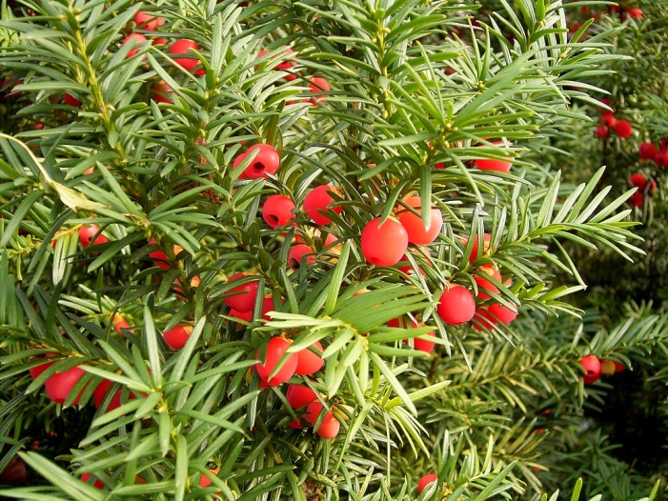
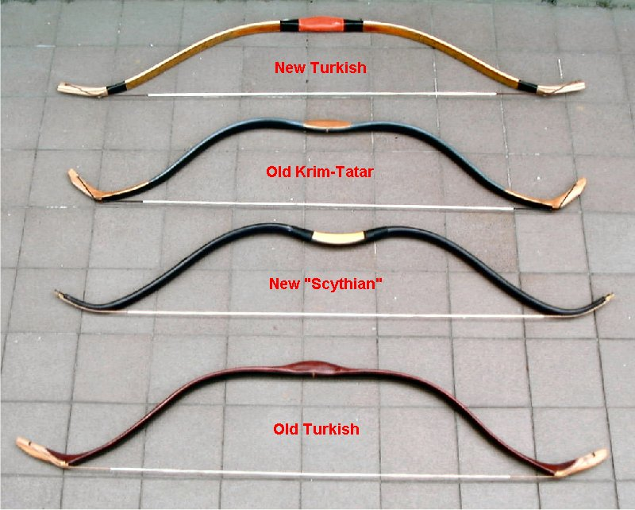
Yew (Taxus baccata)
The wood is heaviest of the soft wood
It is most durable and highly elastic
Used for making bows

Slide 10
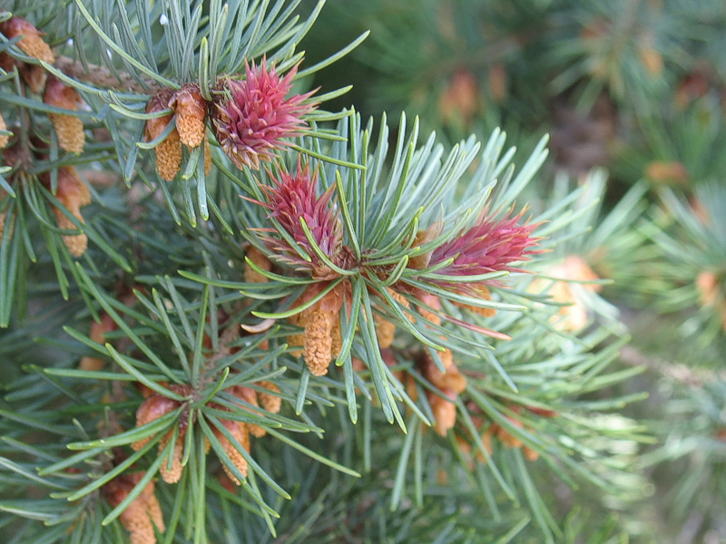
Douglas Fir (Pseudotsuga taxifolia)
Uses:
Yields veeners and plywood
Timber obtained is used for making laminated arches and heavy construction work.

Slide 11
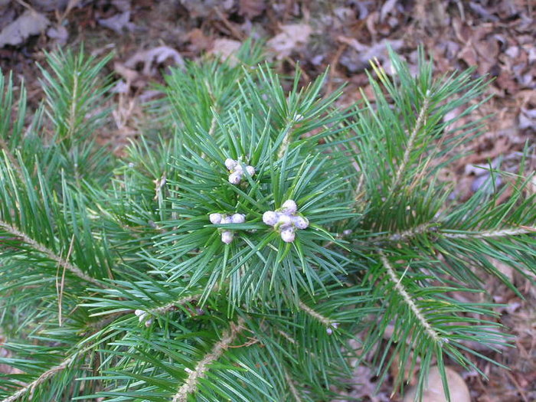


Firs ( Abies pindrow,A. densa, A. delavayi & A.spectabilis
Uses

Slide 12
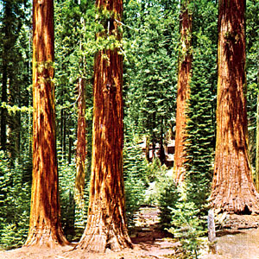
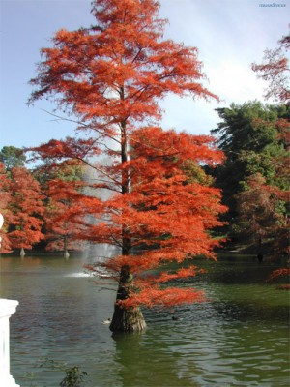
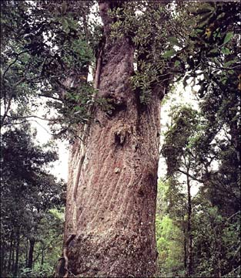
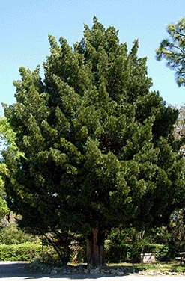
Other timber yielding plants
Sequoia (red wood)
Taxodium distichum
Agathis australis
Podocarpus

Slide 13
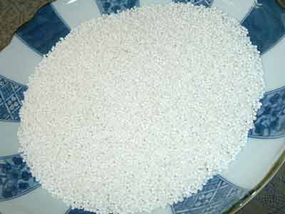
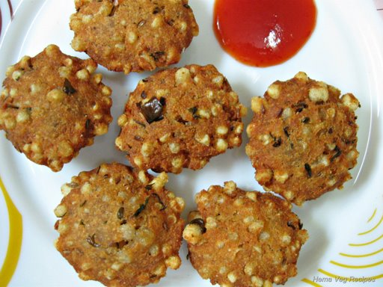
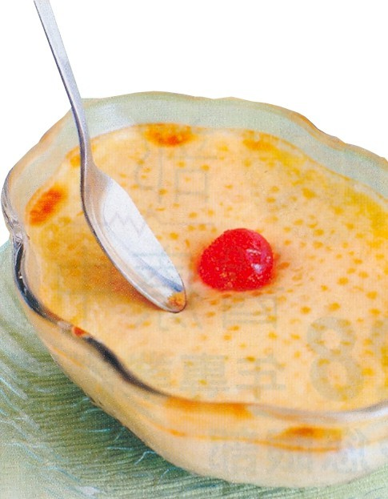
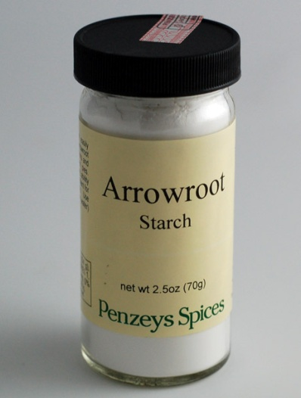
Sago (Sabudana : a starch rich food)

Slide 14
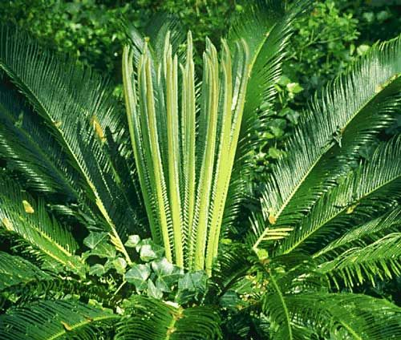
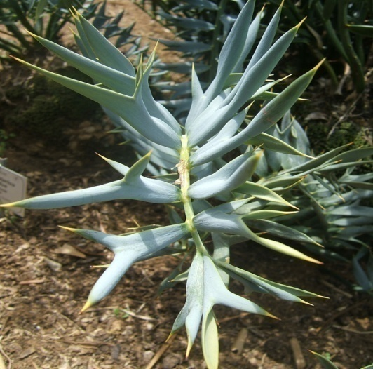
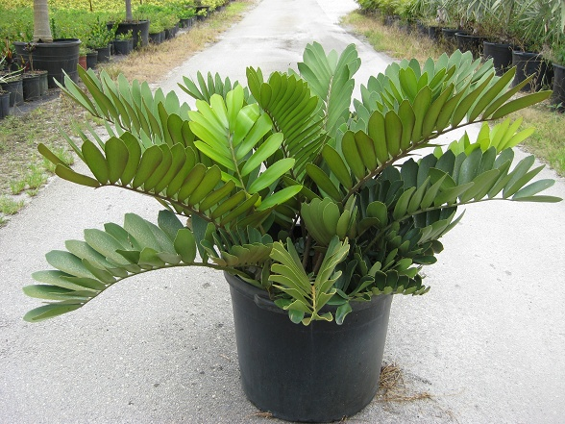
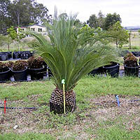
Sago : Obtained from
Cycas sp.
Encephalarios sp.
Zamia sp.
Macrozamia sp.

Slide 15
Other edible products
Young shoots: Cycas pectinata &
C.revoluta
Leaves & strobili: Gnetum genome
Cooked Fruits : Cycas rumphii
Seeds : Pinus gerardiana (chilgoza)
Gnetum genome ,G.ula, G. latifolium
Ginkgo biloba

Slide 16
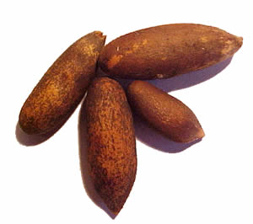
Chilgoza tree & seeds

Slide 17
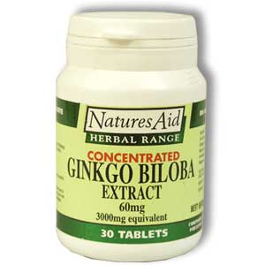
Medicinal uses

Slide 18
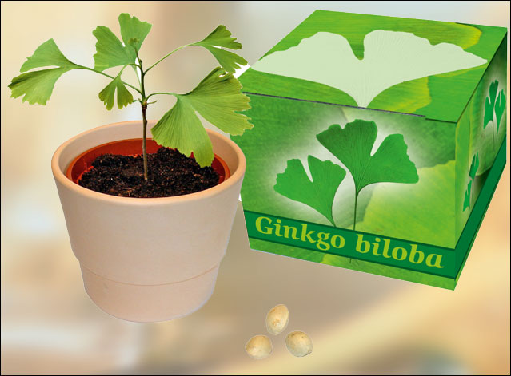

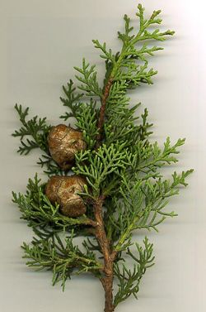
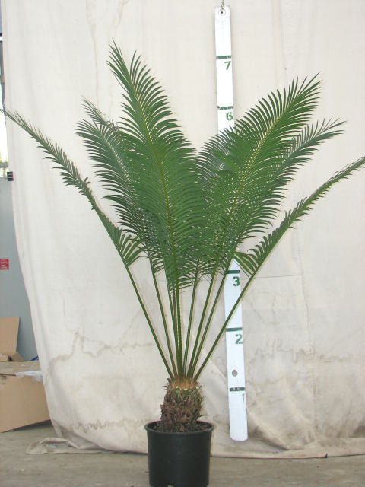
Leaves
Ginkgo
Taxus
Heart,lungs,circulatorydisease
Asthama,bronchitis,epilepsy
Cupresses
Cycas
Vermifuge properties
Stomach & skin disorder,vomitting

Slide 19
Bark and Seeds
The decoction of seeds of Dioon is used for neuralgia
A paste of bark & seeds of Cycas mixed with coconut oil is used as poultice for sores and swelling.
Oil obtained from seeds of Pinus seeds is used as dressing of wounds & ulcers.
Drug obtained from Ephedra sp. used in treatment of asthma ,hay fever and cold.

Slide 20
Resin
The resins are the complex oxidation products of various essential oils
The resins are secreted in ducts and canals of the plants
They are derived from the plant parts in form of fluid, which gradually harden due to evaporation of the oil they contain
They are insoluble in water, but soluble in ether and alcohol

Slide 21
Turpentine Oil
Canada Balsam
Various types of Resins
Copal
Amber
Rosin
Venetian Turpentine

Slide 22
Copal (Agathis australis)
Transparent & very hard resin
Used in :
sprit varnishes, polishes
In preparation of plastic & linoleum

Slide 23
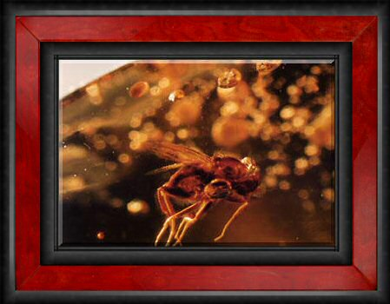
Amber (Pinites succinifera)
Extremely hard and brittle
Used in :
X-ray therapy, in preparation of blood container, mouth pieces of pipes, cigarette holder

Slide 24
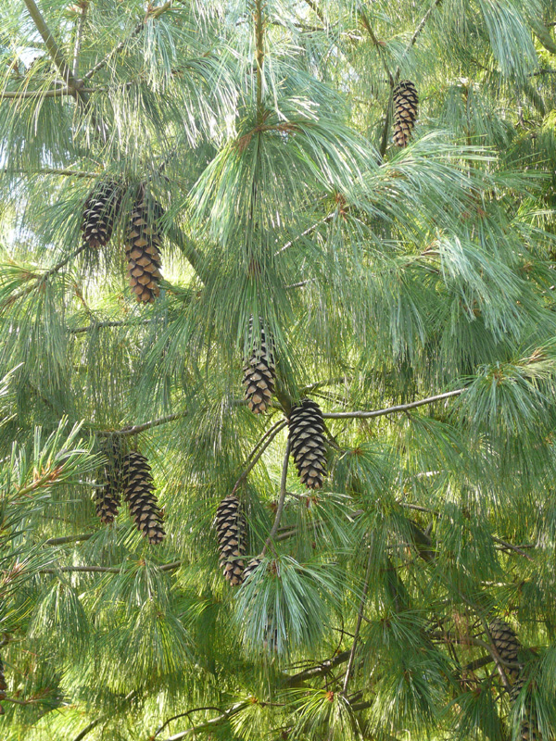
Turpentine oil
Obtained from
P.roxburghii
P. insularis
P. wallichiana
Used in :
Painting

Slide 25
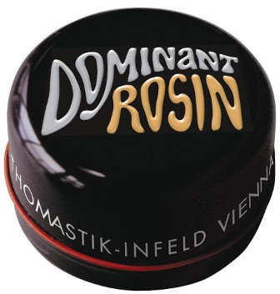
Rosin (Sps. Of Pinus)
Rosin is a brittle, friable and faintly aromatic solid
Used in :
Paper sizing,
Varnish making
Making of soap
Sealing wax
Printer ink
Grease
lubricants

Slide 26
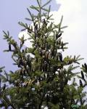
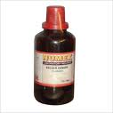
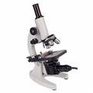
Canada Balsam (Abies balsamea)
Resin does not crystallize on drying & has a high refractive index.
Use:
For mounting microscopic slides.

Slide 27
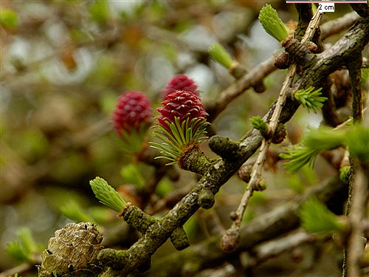
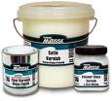
Venetian turpentian (Larix decidua)
Uses:
making varnishes
In veterinary medicines

Slide 28

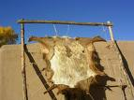
Tannins (Tsugo candesis)
Tanning hides

Slide 29
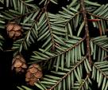


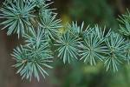

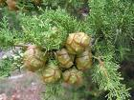
Tsugo sp.
Picea sp.
Essential Oils
Abies sp.
Cedrus sp.
Cupressus Sp.
Juniperus sp.

Slide 30
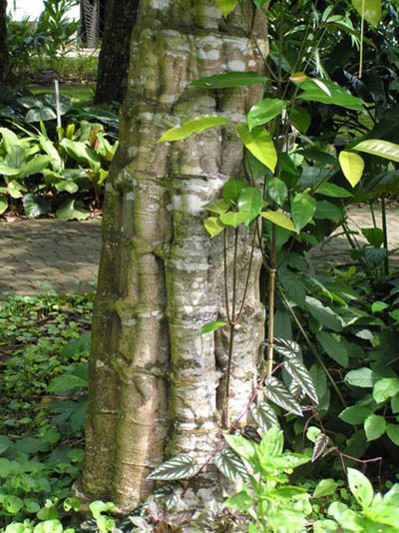
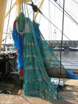

Fibres
Bark of Gnetum sp.
Fishing net
Macrozamia sp.
Stuffing fibre

Slide 31



Picea sp.
Pinus sp.
Paper
Abies sp.
Cryptomeria sp.

Slide 32
Thank You

